Slide 1

Town of Coventry Town Manager’s Proposed Budget FY 2023-2024 March 9, 2023 CHS Lecture Hall
Proposed Annual Budget Hearing
John Elsesser, Town Manager
www.Coventryct.org

Slide 2

Town Manager’s Proposed Budget
Budget Process Video:

Slide 3
Town Manager’s Proposed Budget
“…as we know, there are known knowns; there are things we know we know. We also know there are known unknowns; that is to say we know there are some things we do not know.”
Donald Rumsfield

Slide 4
Known Knowns
Utilities: Electric, Fuel Oil
Commodity Pricing (e.g. Road Salt)
Additional recreation fields coming online
3 Softball and 2 Football
Minimum wage increase impacts
Insurance costs
Worker’s Comp, Liability, Health
Pension increase due to market losses

Slide 5
Known Unknowns
State aid cuts/increases
Education aid cuts, EMS Medicaid reimbursement, Newspaper Ads
Voter opinion
Turn out, support/non-support
Medical Experience
Grant Outcomes
On-going impacts to implement
New unfunded State Mandates
Discussion of using our taxes for programs
Union wages for 4 town contracts and 8 pension units
Lake: Blue-green algae and/or Hydrilla

Slide 6

Things We Do Not Know
If we knew – it would be in the budget!!

Slide 7
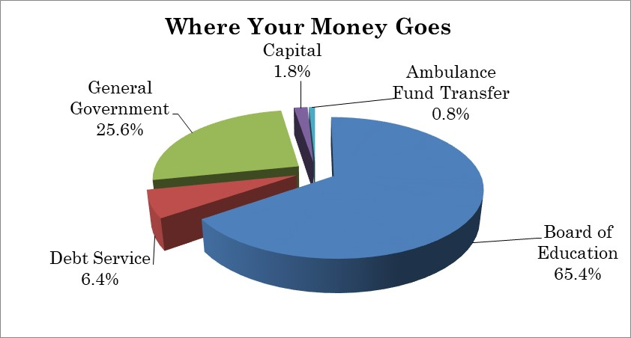
Highlights of Proposed Budget
The proposed budget increases total spending by $1,898,995 or 4.35%
Spending increase of 4.35% $175,000 use of fund balance as revenue Manager’s budget proposes a mil rate of 32.57: a 1.42 mil or 4.55% increase. No additional staff proposed.
Change from Adopted FY 22/23 Budget
Education increase $1,111,869
Town increase $723,938
Capital increase $96,500
Ambulance fund increase $0
Debt decrease ($33,312)
Total change $1,898,995

Slide 8
COMPARISON OF FY 2022/2023 and FY 2023/2024 BUDGETS

Slide 9
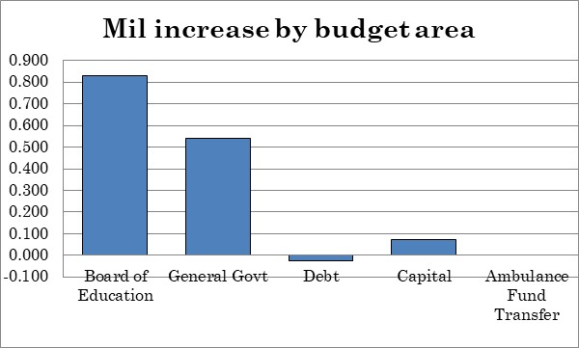
Where is the change?

Slide 10
Where do we get our Revenue?
State revenues based on Governor’s Proposed State budget (decrease of $134,919).
Subject to legislative change.
Grand list growth of 1.8% (approximately $600,000 at the FY23 mil rate).
Tax collection rate restored to past practice formula at a 98.75 % collection rate.
Local revenues are stable with a slight increase.
$175,000 use of fund balance: no change from prior year.
$125,000 one time American Rescue plan money was used to subsidize FY 23/24 budget (0.13 mil impact).

Slide 11
Inflationary Impact
The Consumer Price Index (CPI), computed and published by the U.S. Bureau of Labor Statistics, is a measure of the average change in prices over time in a fixed market basket of goods and services. It is based on prices of food, clothing, shelter, fuels, transportation fares, charges for doctors’ and dentists’ services, drugs and other goods and services that people buy for their day-to-day living.
* CPI data obtained from the U.S. Bureau of Labor and Statistics for the January within each fiscal year.

Slide 12
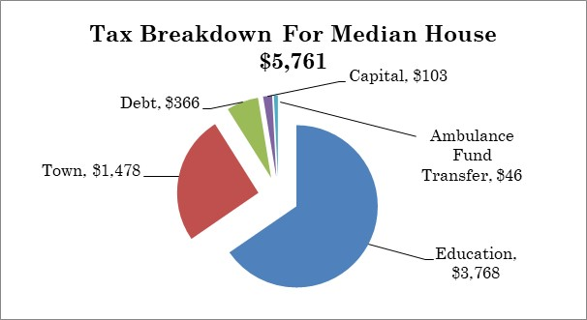
Where the Money Goes (TAXES ON MEDIAN HOUSE)
Median house assessed at $176,890 ($252,700 market)
Total proposed tax: $5,761
A monthly increase of $20.93 from previous year

Slide 13
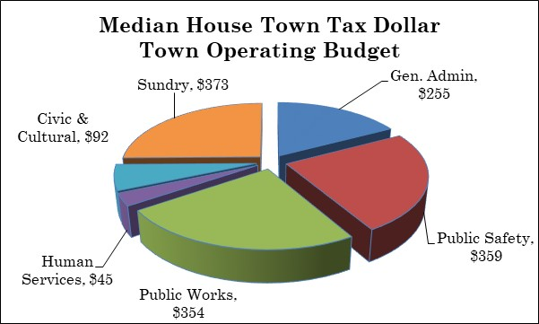
Cost of Town Service on Median House
General Government share of bill = $1,478 of $5,761 total
(25.7% of total bill)

Slide 14
Detail of Changes to Town Budget

Slide 15
Major Town Budget Impacts
Personnel - $622,743
GOOD NEWS
Pension fund is strong
No service cuts
Grants have been strong: roads, arts, sidewalks, solar, bridges, energy savings, housing rehab.
Improvements to parks and buildings
Health Insurance | $114,400
Pension ADEC | $70,089
Sick and Severance Fund contribution | $80,000
Contractual Services – ($15,336)
Legal | ($10,000)
Service Contracts | ($35,006)
IT Services | $47,210
Supplies - $104,608
Gasoline | $24,510
Diesel | $27,625
Cement, Sand, Salt, Gravel & Ground Supplies | $24,660
Capital – $750
Utilities – $11,173

Slide 16
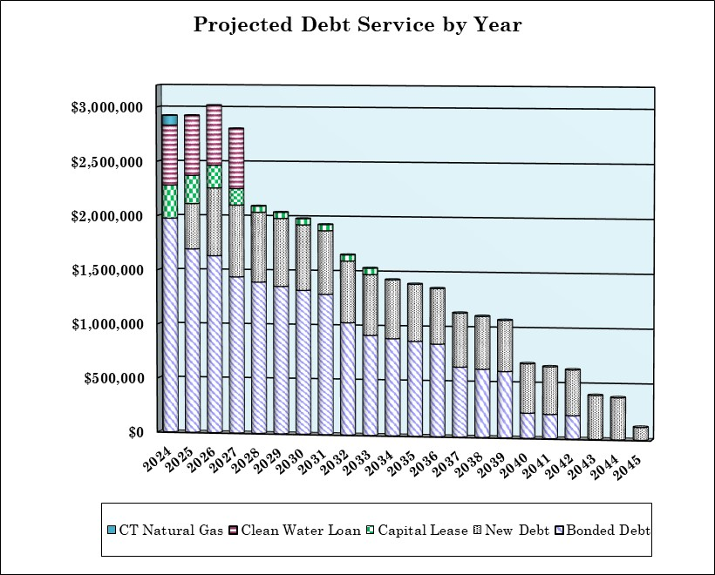
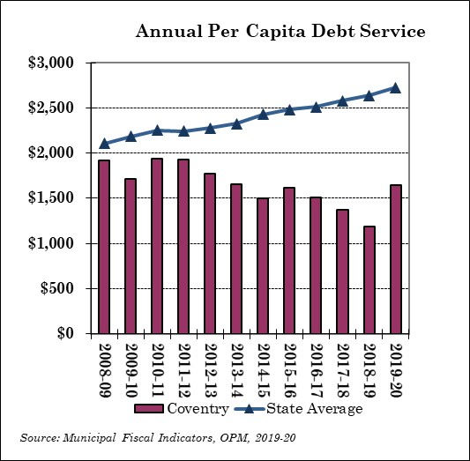
Debt Service
Debt Service is (1.14%)% or ($33,312) decrease.
Debt service is anticipated to increase in FY25 and FY26 based on the issuance of previously approved road and HVAC bonds. The good news is that the Town’s long term bonded debt will then continue to decline or allow other needed projects to proceed without a major tax impact.
Debt service is 6.4% of the proposed budget.

Slide 17
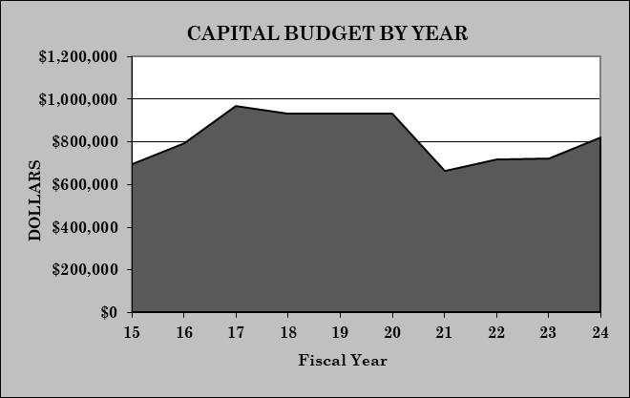
Capital Budget Highlights
Capital budget increased by $96,500 or 13.34%.
Sustainability level is $1,000,000 (proposed is at 82% of target)
In FY20 the Capital Budget was $932,000. This proposal is still $112,000 less than Pre-Covid spending.
Note: FY 95 levels, if adjusted for inflation, would be over $1,000,000

Slide 18
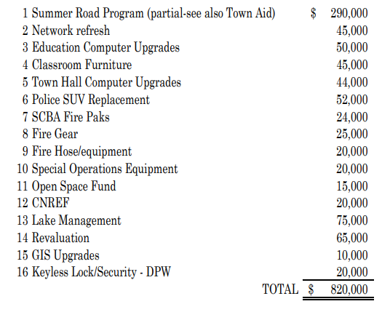
Capital Projects
GENERAL FUND CAPITAL EXPENDITURES:

Slide 19
Capital Projects (Continued)
LOCIP:
1 | Patriots Park Improvements | $25,000
2 | Laidlaw Park Improvements | $12,000
3 | Miller Richardson Improvements | $10,000
4 | Lisicke Beach Improvements | $10,000
5 | Fire Pond Maintenance | $10,000
6 | Police Station Updates | $15,000
7 | Pickle Ball Court Repair | $19,000
 | Total | $101,000
Other Funds:
1 | Document Management | Local Locip | $10,000
2 | Cemetery Expansion/Improvement | Cemetery Fund | $5,000
3 | Kitchen Equipment | Cafeteria Fund | $20,000
4 | Park Improvements | Recreation Fund | $5,000
5 | Pump Station Improvements | Sewer Fund | $15,000
6 | Fine Cut Mower | Misc. Highway Fund | $16,000
7 | In-Kind |  | $105,460
 | Total |  | $176,460

Slide 20
Capital Projects (Continued)
Grants:
1 | School HVAC | $3,000,000
2 | Public Water Supply | $6,000,000
3 | Cemetery Wall Repair | $5,000
4 | Daly Road Safety Improvements | $3,000,000
5 | Hop River Trail Signage | $44,740
6 | Recreational Trail – Hunt Property | $128,000
7 | Depot Road Bridge | $791,400
8 | Brigham Road Bridge | $556,650
9 | Hop River Road Bridge | $385,000
 | Total | $13,910,790

Slide 21
Additional Details
The Town Manager’s budget can be accessed as a pdf at:
https://www.coventryct.org/644/FY23-24-Town-Manager-Proposed-Budget
The Town Manager’s budget can also be viewed electronically at:
https://town-coventry-ct-budget-book.cleargov.com/7767/

Slide 22
Budget Vote!
Vote: Tuesday May 2nd 6:00 A.M. to 8:00 P.M.
District 1: CVFA Firehouse
District 2: NCFD Firehouse
Absentee Ballots will be available at the Office of Town Clerk during business hours

