Slide 1

Town of Coventry
Town Council’s Revised Proposed Budget
FY2022 - 2023
Special Budget Meeting
June 20, 2022
Lisa Thomas, Council Chair
www.coventryct.org

Slide 2
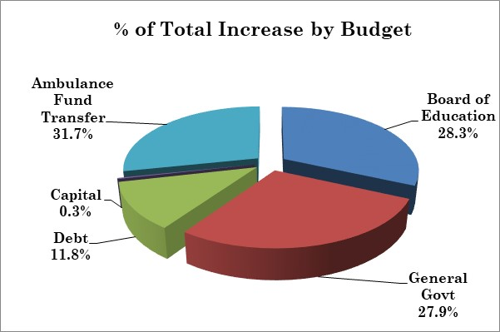
Comparison of FY22 and FY23 Budget

Slide 3
How did we get here?
1. Town Manager Requested Budget: March 7, 2022
To fund the Town Manager’s Requested budget, the Town would need a mil rate of 32.58. This is a 1.43 mil or 4.6% increase from the prior year.

Slide 4
How did we get here?
2. Town Council Proposed Budget: April 4, 2022
To fund the Town Council’s 4/4/22 Proposed budget, the Town would need a mil rate of 31.99. This is a 0.84 mil or 2.7% increase from the prior year.

Slide 5
How did we get here?
3. Town Council Proposed Budget: May 16, 2022
To fund the Town Council’s 5/16/22 Proposed budget, the Town would need a mil rate of 31.61. This is a 0.46 mil or 1.48% increase from the prior year.

Slide 6
How did we get here?
4. Town Council Current Proposed Budget: 6/13/2022
To fund the Town Council’s Current Proposed budget include
NO INCREASE
to the mil rate of 31.15

Slide 7
What was cut?
General Government:
Elimination of Assistant Town Manager $33,750
Elimination of DPW Maintainer I $55,600
Elimination of Sick & Severance Fund $25,000
Freeze vacant Police position until Jan 1 $9,000
Delay additional DPW summer help $4,900
Reduction of Sand/Salt Budget $7,000
Reduction of Tree Removal Budget $10,000 (See Capital)
Reduction to Library Budget Requested $7,500
Reduction to LAP/WC Insurance Budget $10,000
Reduction of Contingency $10,000
Vacancy Savings $16,600
Total Reductions: $257,815

Slide 8
What was cut?
Board of Education:
Council reduced by $315,000

Slide 9
What was cut?
Debt Service:
Delay lease of small dump truck $20,000
Finalized debt issuance in June –
  Increase of $99,855 for debt payments
  Use $120,000 of Bond Premium
Total Reductions: $40,145

Slide 10
What was cut?
Capital:
BOE Carpet Replacement $10,000
DPW Dump Truck Body Replacement $12,000
Delay purchase of DPW Pickup Truck $50,000
Reduce BOE Computers $30,000
Delay purchase of Police Vehicle $43,000
Increase of $40,000 for Tree Removal
Total Reductions: $105,000

Slide 11
What was cut?
Ambulance:
Remove capital funding $62,500
Council reduction of $75,000
  Rate increase on January 1
  Evaluation use of Volunteers for some shifts
Total Reductions: $137,500
Total transfer equals ONLY 0.8% of the Total Budget!
This fund will be evaluated through-out the year to ensure continued service.

Slide 12
Revenue Impacts
Use of an additional $200,000 of Federal ARP funds
Supplemental Motor Vehicle Tax Revenue $80,000
Local Town Clerk Revenues $30,000
Sewer Use Contribution $20,000
Use of Fund Balance $25,000
Total Revenue Increase: $355,000
What Next???

Slide 13
Budget Vote!!!
Vote: Tuesday June 28, 2022
  6:00 AM to 8:00 PM
  District 1: Station 118 (CVFA Firehouse)
  District 2: Station 218 (NCFD Firehouse)
  Absentee Ballots will be available at the Office of the Town Clerk during business hours

