Slide 1

Town of Coventry
Town Council’s Revised Proposed Budget
FY2022 - 2023
Special Budget Meeting
May 25, 2022
Lisa Thomas, Council Chair
www.coventryct.org

Slide 2
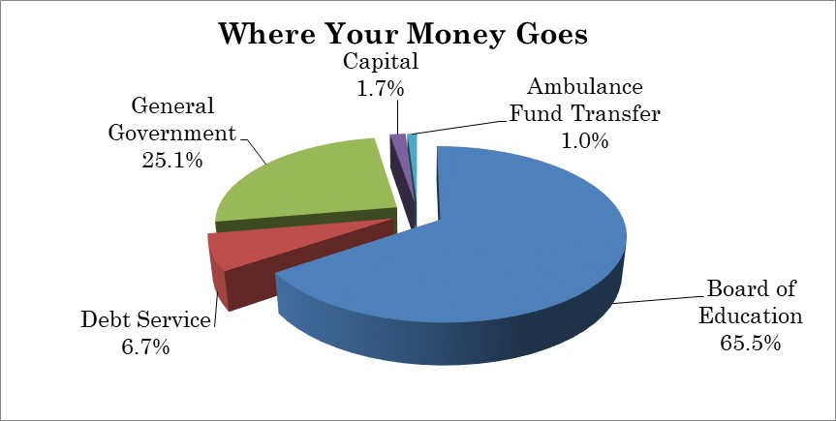
Highlights of Proposed Budget
The proposed FY2023 budget increases total spending by $1,618,560 or 3.82%.
$150,000 use of fund balance
Includes ambulance subsidy for 24/7 staffing
  Only 1% of total expenditure budget proposed!
Revised Council proposed budget currently would require a mil rate of 31.61, a 0.46 or 1.48% increase. This is a reduction from their initial budget which included an increase of 0.84 or 2.70%

Slide 3
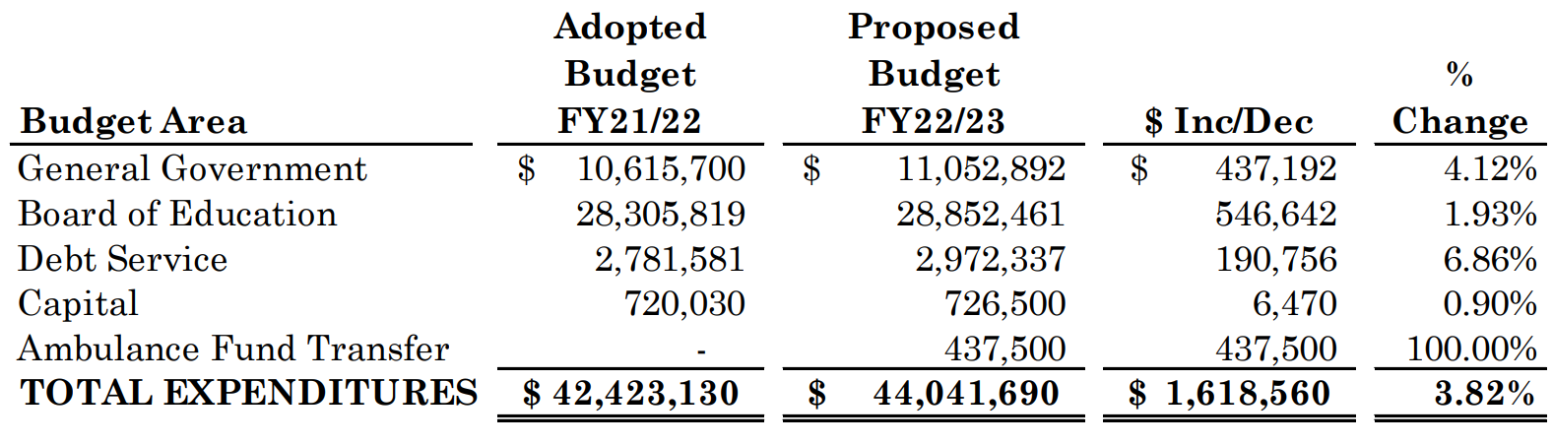
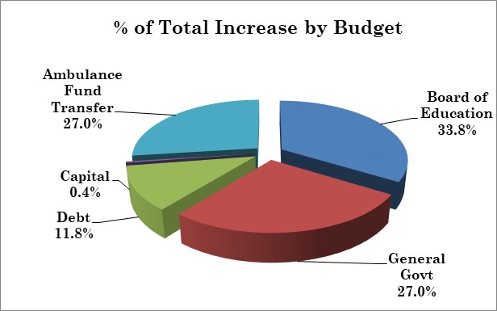
Comparison of FY22 and FY23 Budget

Slide 4
FY22 Budget Impacts on FY23
Description | Adopted FY22 Budget | Proposed FY23 Budget | $$ Impact | Mil
Revenues:
ARP Funding | $150,000 | $250,000 | ($100,000) | (0.09)
Use of Fund Balance | $200,000 | $150,000 | $50,000 | 0.05
Sewer Debt Transfer | $478,993 | $355,000 | $123,993 | 0.12
Expenses:
Restore Police Officer | $- | $23,500 | $23,500 | 0.02
Ambulance Fund Transfer | $- | $437,500 | $437,500 | 0.42
 |  | TOTAL | $734,993 | 0.52
Proposed mil increase is 0.46

Slide 5
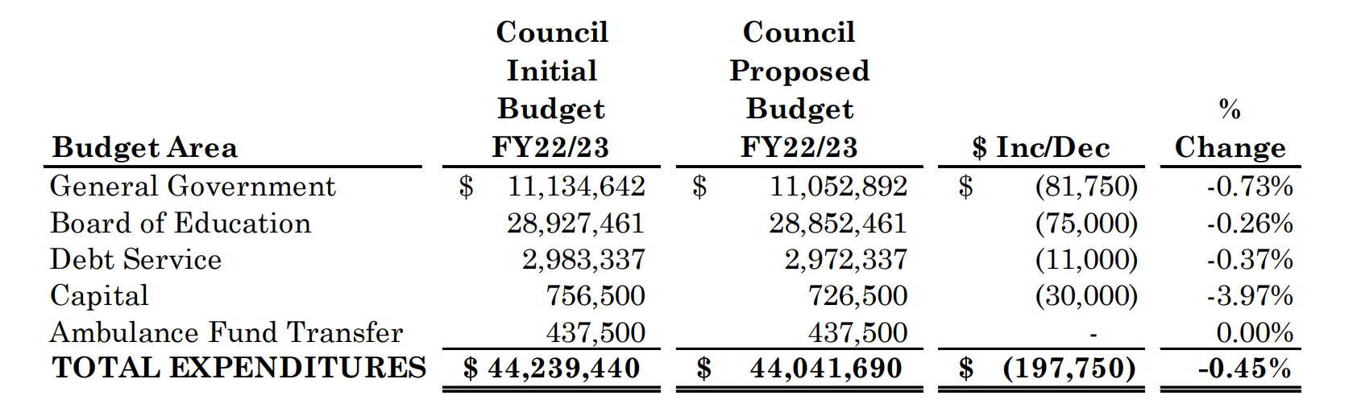
Council Adjustments from Original Budget
Council reductions from their original proposed budget include removal of Assistant Town Manager, delay of hiring DPW Maintainer 1 to January 1, reduction in salt and tree removal budgets, $10,000 in staff turnover savings identified subsequent to the original budget, a reduction to the Board of Education operating and capital budgets, and cutting the lease purchasing a pick up truck.
In addition, the Council authorized an additional $200,000 in American Rescue Plan funds to be used towards the FY23 budget to help offset the increased cost of ambulance service to tax payers.

Slide 6
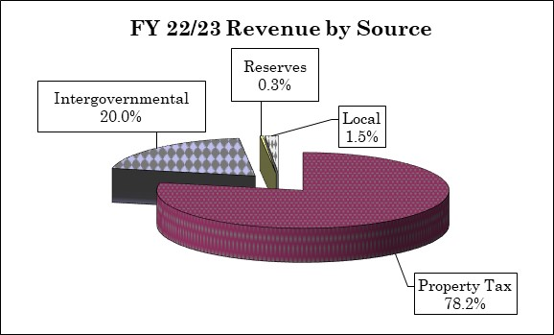
Where do we get our Revenue?
State revenuers based on Governor’s proposed State budget.
Grand List growth of 3.64% from prior year.
Tax collection rate restored to past practice formula at 98.80%
Phase out of COVID 19 use: $150,000 use of fund balance and $250,000 of American Rescue Plan funding proposed.
Current proposal requires estimated mil rate of 31.61, an increase of 0.46 mil or 1.48% (lower than original budget proposal of an increase of 0.84 mil or 2.70%). SUBJECT TO COUNCIL AUTHORIZATION

Slide 7
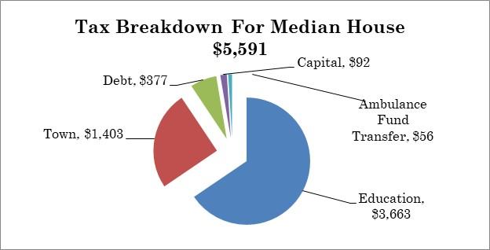
Where does your Money Go??
Median house assessed at $179,890 ($252,700 market value)
Total proposed tax per year: $5,591
A monthly increase of $6.78
Council original budget was an increase of $12.38 from previous year

Slide 8
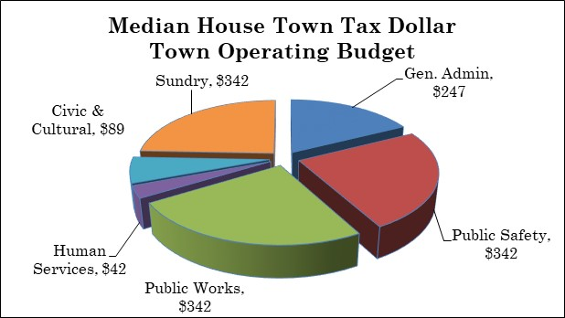
Breakdown of Cost of Town Services
General Government represents $1,403 of the median bill of $5,591
(25.1% of total bill)

Slide 9
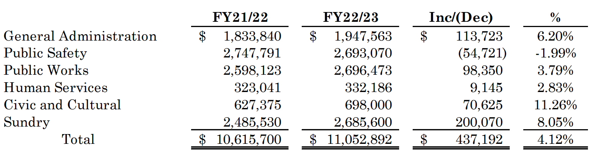
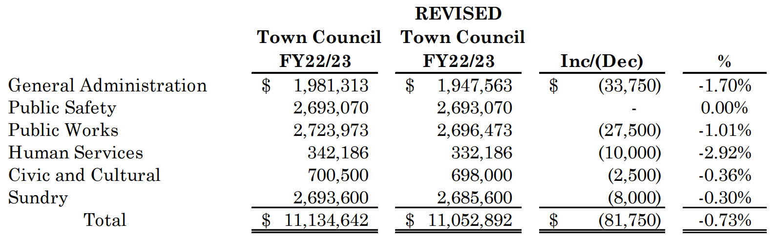
Details of Changes to Town Budget
Summary by
Department
Council changes
From original
budget
Of this decrease, $67,750 was related to personnel costs

Slide 10
Main Budget Driver: Personnel Expense Changes
Health insurance – 9.0% premium increase due to poor experience. Employee portion of benefits will increase. ($116,100).
Pension expense increased by 4.5% to maintain recommended funding levels. Changes in investment return made to reflect experience.
Several new positions and additional hours are proposed in the original Council budget. The Assistant Town Manager was removed and the DPW maintainer delayed. Changes in staffing under the proposed budget are as follows:
Personnel services (wages and benefits), which makes up 74.3% of the Town Budget,
is increasing $463,937 over prior year (5.99%).
Staff increase of only 0.74 positions
 |  | FY22 |  | FY23 |  | Change
General Government |  | 15.96 |  | 16.15 |  | 0.19
Public Safety |  | 25.5 |  | 25.5 |  | 0.00
Public Works |  | 21.24 |  | 21.79 |  | 0.55
Human Services |  | 4.5 |  | 4.5 |  | 0.00
Civic & Culture |  | 1.0 |  | 1.0 |  | 0.00

Slide 11
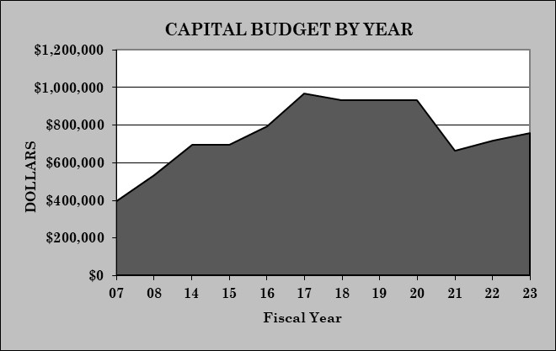
Capital Budget Highlights
Capital budget increased by $6,470 or 0.90%. No funding for CNREF
Sustainability level is $1,000,000 (proposed is at 82% of target)
Includes restoration of several Education projects after elimination of all projects 2 years ago at suggestion of Board to address Covid-19
In FY20 the Capital Budget was $932,000. This proposal is still $206,000 less than Pre-Covid spending

Slide 12
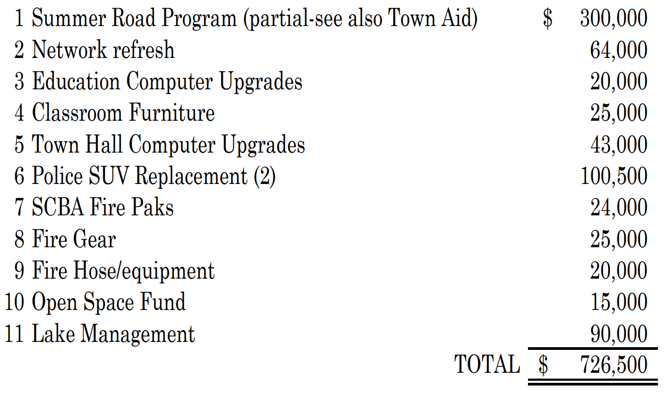
Capital Projects – General Fund Funded
The Town Council has further reduced the Capital budget by $30,000. This reduction will impact the Education Computer Upgrades.

Slide 13
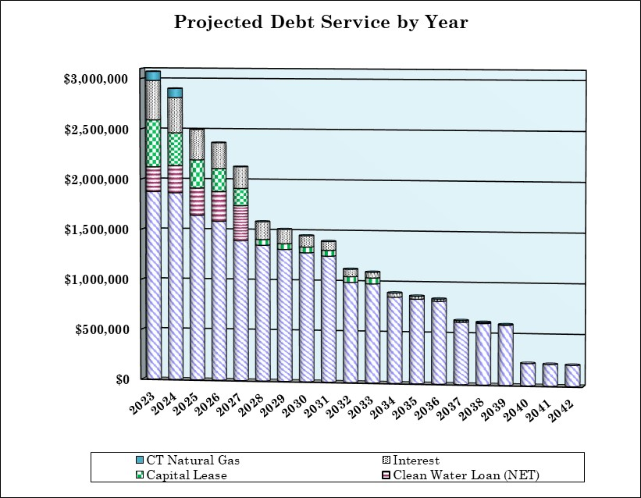
Debt Service
Debt Service is 6.7% or $190,756 increase. Includes projected issuance of debt which was previously approved by taxpayers for:
  Library renovation ($750,000),
  School roof replacement ($3,105,000)
  Softball field ($325,000).
  This increase represents less than 0.2 mils.
Debt service is 11.8% of the proposed budget increase.

Slide 14
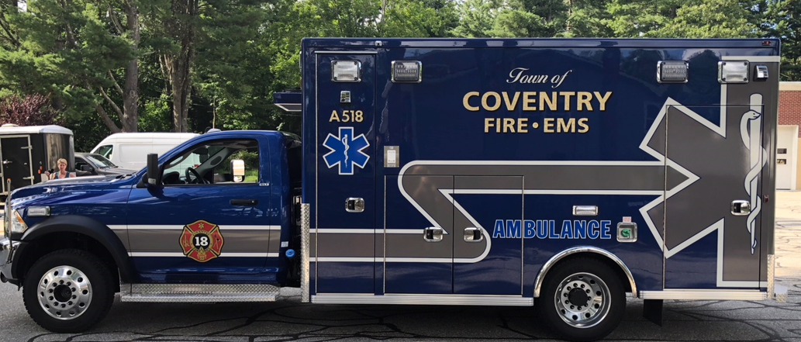
Ambulance Transfer
Transfer Request of $437,500 included in the FY23 budget
Total transfer represents 0.42 mil. The Council has authorized $250,000 in American Rescue Act funding to help offset this cost – resulting in a mil imapact of 0.18 mil.
Provides 24/7 ambulance coverage to the Town
Decrease in volunteers, limited transport reimbursement (50% Medicare and 30% Medicaid)
Without this transfer, residents will rely on mutual aid from other Towns which can significantly impact response time
Total transfer equals ONLY 1.0% of the Total Budget!

Slide 15
Budget Vote?!
Vote: Tuesday June 7, 2022
  6:00 AM to 8:00 PM
  District 1: Station 118 (CVFA Firehouse)
  District 2: Station 218 (NCFD Firehouse)
  Absentee Ballots will be available at the Office of the Town Clerk during business hours

