Slide 1

Town of Coventry Town Council’s Proposed Budget FY2022 - 2023
Annual Town Meeting
April 24, 2022
Lisa Thomas, Council Chair
www.coventryct.org

Slide 2
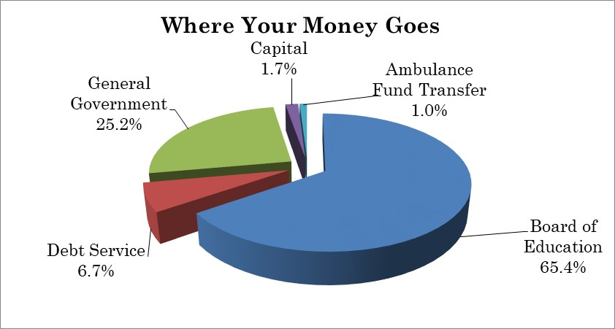
Highlights of Proposed Budget
The proposed FY2023 budget increases total spending by $1,816,310 or 4.28%.
$150,000 use of fund balance
Includes ambulance subsidy for 24/7 staffing
Only 1% of total expenditure budget proposed!
Council proposed budget currently would require a mil rate of 31.99, a 0.84 or 2.70% (still waiting on final State budget numbers)

Slide 3
FY22 Budget Impacts on FY23
Description | Adopted FY22 Budget | Proposed FY23 Budget | $$ Impact | Mil
Revenues:
ARP Funding | $150,000 | $50,000 | $100,000 | 0.09
Use of Fund Balance | $200,000 | $150,000 | $50,000 | 0.05
Sewer Debt Transfer | $478,993 | $355,000 | $123,993 | 0.12
Expenses:
Restore Police Officer | $- | $23,500 | $23,500 | 0.02
Ambulance Fund Transfer | $- | $437,500 | $437,500 | 0.42
 |  | TOTAL | $734,993 | 0.70

Slide 4
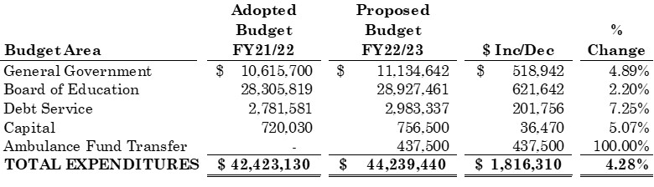
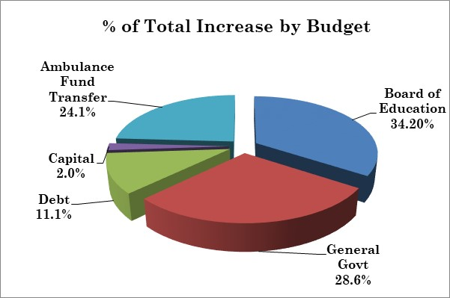
Comparison of FY22 and FY23 Budget

Slide 5
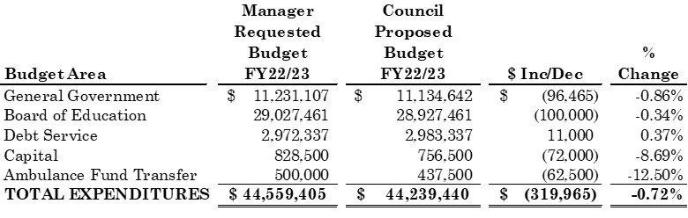
Council Adjustments

Slide 6
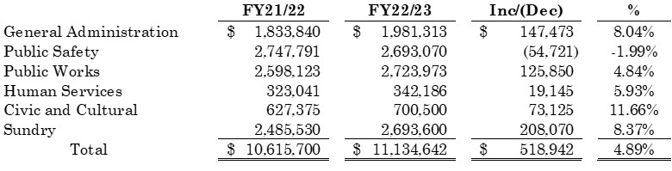
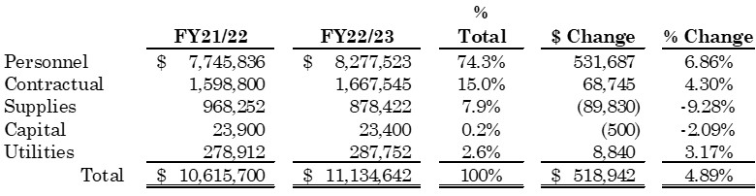
Details of Changes to Town Budget

Slide 7
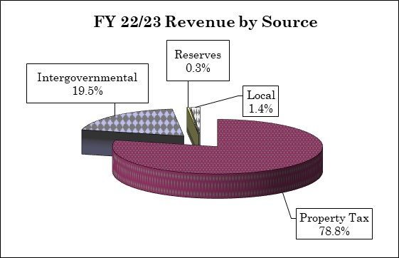
Where do we get our Revenue?
State revenuers based on Governor’s proposed State budget. SUBJECT TO LEGISLATIVE CHANGES
Grand List growth of 3.64% from prior year.
Tax collection rate restored to past practice formula at 98.80%
Phase out of COVID 19 use: $150,000 use of fund balance and $50,000 of American Rescue Plan funding proposed.
Current proposal requires estimated mil rate of 31.99, an increase of 0.84 mil or 2.70%. SUBJECT TO COUNCIL

Slide 8
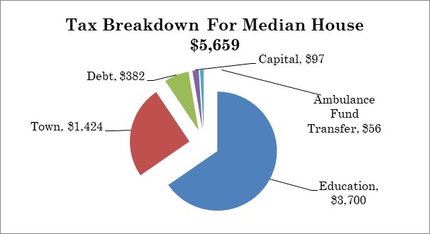
Where does your Money Go??
Median house assessed at $179,890 ($252,700 market value)
Total proposed tax per year: $5,659
A monthly increase of $12.38 from previous year

Slide 9
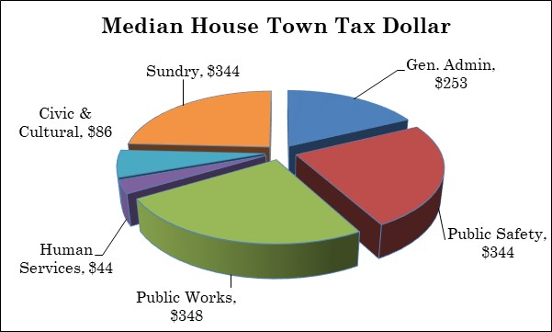
Breakdown of Cost of Town Services
General Government represents $1,424 of the median bill of $5,659 (25.2% of total bill)

Slide 10
Main Budget Driver: Personnel Expense Changes
Two unions have approved contracts for July 1. Wages for non-union and settled contract vary from 2.25% to 2.5% depending on union, with increases in insurance cost share. Town is currently in negotiations for AFSCME pension.
Health insurance – 9.0% premium increase due to poor experience. Employee portion of benefits will increase. ($116,100).
Pension expense increased by 4.5% to maintain recommended funding levels. Changes in investment return made to reflect experience.
Several new positions and additional hours are proposed:
7 hours wetlands agent, full-time custodian instead of contract, one summer laborer, DPW maintainer 1 (10/1), 50% Assistant Town Manager (10/1), PT Engineering Tech (grant offsets), Restoring police officer previously frozen (50%), Captain Promotion (1/1).
Personnel services (wages and benefits), which makes up 74.3% of the Town Budget, is increasing $531,687 over prior year (6.86%).

Slide 11
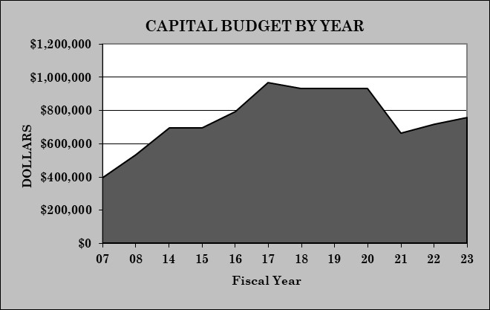
Capital Budget Highlights
Capital budget increased by $36,470 or 5.07%. No funding for CNREF ($50,000 cut)
Sustainability level is $1,000,000 (proposed is at 82% of target)
Includes restoration of several Education projects after elimination of all projects 2 years ago at suggestion of Board to address Covid-19
In FY20 the Capital Budget was $932,000. This proposal is still $175,500 less than Pre-Covid spending (equals 0.16 mil increase)

Slide 12
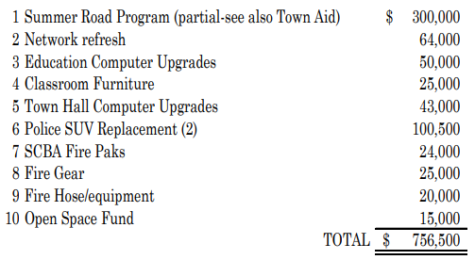
Capital Projects – General Fund Funded

Slide 13
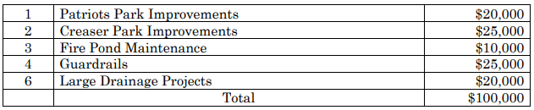
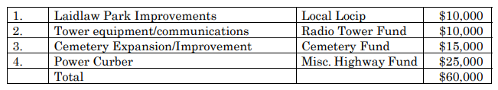

Capital Projects – Other Funding Sources
LOCIP:
Other Funds:
Grants:

Slide 14
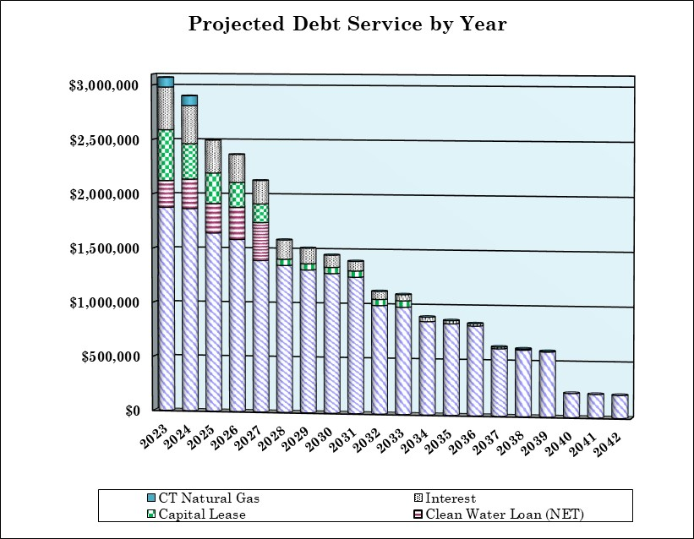
Debt Service
Debt Service is 6.7% or $201,756 increase. Includes projected issuance of debt for the library renovation ($750,000), school roof replacement ($3,105,000) and softball field ($325,000). This increase represents less than 0.2 mils.
Debt Service for the proposed bond projects is included in the budget to take advantage of debt repayment decline and attractive rates.
Debt service is 11.1% of the proposed budget increase.

Slide 15
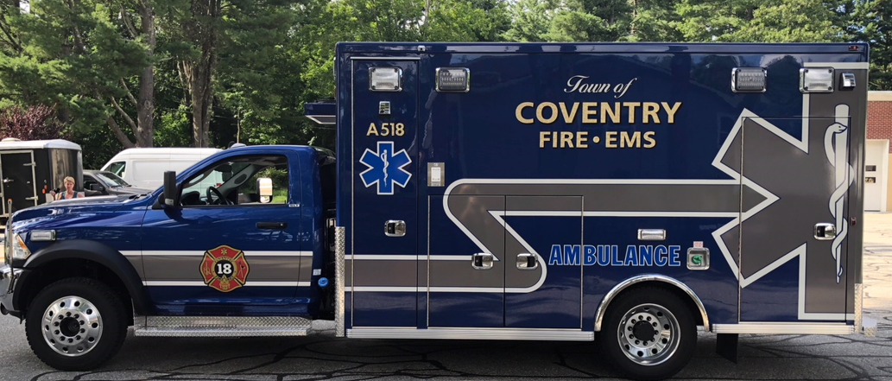
Ambulance Transfer
Transfer Request of $437,500 included in the FY23 budget (represents half of the proposed mil increase)
Provides 24/7 ambulance coverage to the Town
Decrease in volunteers, limited transport reimbursement (50% Medicare and 30% Medicaid)
Without this transfer, residents will rely on mutual aid from other Towns which can significantly impact response time
Total transfer equals ONLY 1.0% of the Total Budget!

Slide 16
Budget Vote?!
Vote: Tuesday May 3, 2022
6:00 AM to 8:00 PM
District 1: Station 118 (CVFA Firehouse)
District 2: Station 218 (NCFD Firehouse)
Absentee Ballots will be available at the Office of the Town Clerk during business hours

