Slide 1

Town of Coventry
Town Manager’s Proposed Budget
FY 2022-2023
March 10, 2022 CHS Lecture Hall
Proposed Annual Budget Hearing
John Elsesser, Town Manager
www.Coventryct.org

Slide 2
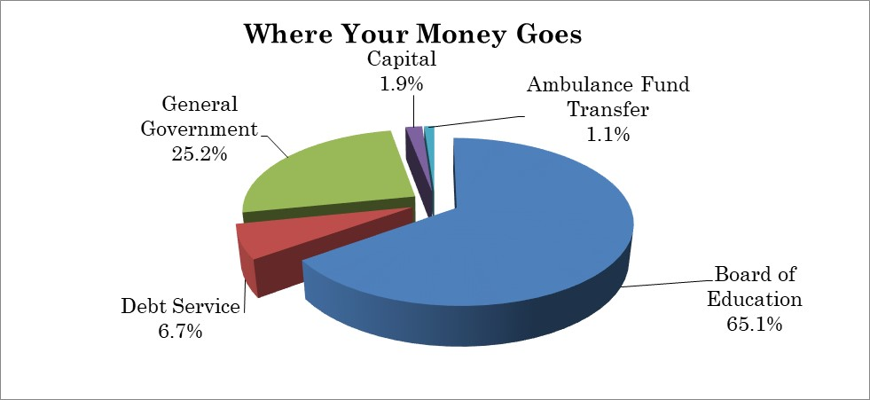
Highlights of Proposed Budget
The proposed budget increases total spending by $2,136,275 or 5.04%
Spending increase of 5.04% $100,000 use of fund balance as revenue ( $100,000 reduction) Manager’s budget proposes a mil rate of 32.58: a 1.43 mil or 4.60% increase. Ambulance subsidy for 24/7 staffing agency
Change from Adopted FY 21/22 Budget
Education increase $721,642
Town increase $615,407
Capital increase $108,470
Ambulance fund increase $500,000
Debt increase $190,756
Total change $2,136,275

Slide 3
FY22 Budget Impacts on FY23
American Rescue Plan Funding: $150,000 used in the FY22 budget. None proposed in FY23.
Sewer Use Contribution: $190,000 was contributed from the Sewer Use Fund in FY22 to assist with Clean Water Loan payments. $55,000 is proposed in FY23.
Use of Fund Balance: $200,000 was used in FY22. $100,000 is proposed in FY23.
Police Officer: One officer was funded through American Rescue Plan funding in FY22 ($0 charged to budget). 50% of this officer is being funded in FY23 ($32,350)
Total impact $417,350, 0.45 mils

Slide 4
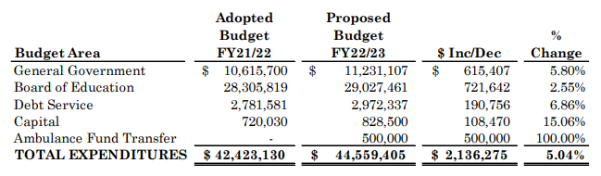
COMPARISON OF FY 2021/2022 and FY 2022/2023 BUDGETS

Slide 5
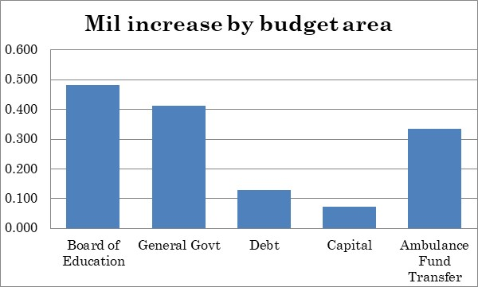
Where is the change?

Slide 6
Detail of Changes to Town Budget

Slide 7
Where do we get our Revenue?
State revenues based on Governor’s Proposed State budget. Subject to legislative change.
Grand list growth of 3.64%.
Tax collection rate restored to past practice formula at a 98.8 % collection rate
Local revenues are stable.
$100,000 use of fund balance: Phasing out Covid-19 use per plan. This has a 0.1 mil increase on the proposed mil rate.
$150,000 one time American Rescue plan money was used to subsidize FY 21/22 budget (0.15 mil impact).

Slide 8
Where the Money Goes
(TAXES ON MEDIAN HOUSE)
Median house assessed at $176,890 ($252,700 market)
Total proposed tax: $5,763
A monthly increase of $21.08 from previous year

Slide 9
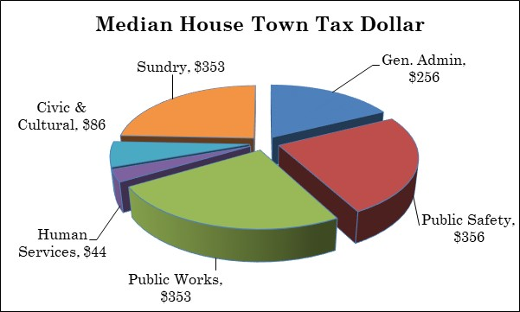
Cost of Town Service on
Median House
General Government share of bill = $1,453 of $5,763 total
(25.2% of total bill)

Slide 10
Major Town Budget impacts
Contractual Services
GOOD NEWS
Pension fund is strong
No service cuts
Grants have been strong: roads, arts, sidewalks, solar, bridges, energy savings, housing rehab.
Improvements to parks and buildings
IT contracted services | $36,900
Software Licenses | $18,110
Tree removal | $10,000
Legal | $5,000
Service Contracts | ($9,704)
Workers’ compensation & LAP insurance | $14,290
Negotiated Union Contracts (Tuition reimbursement) | ($7,000)
Supplies
Transfers to other funds | ($103,700)
Severance Fund | $25,000
Subscription books | $4,545

Slide 11
Personnel Expense Changes
Two unions have approved contracts for July 1. Wages for non-union and settled contract vary from 2.25% to 2.5% depending on union, with increases in insurance cost share. Town is currently in negotiations for AFSCME pension.
Health insurance – 9.0% premium increase due to poor experience. Employee portion of benefits will increase. ($116,100).
Pension expense increased by 4.5% to maintain recommended funding levels. Changes in investment return made to reflect experience.
Several new positions and additional hours are proposed:
7 hours wetlands agent, full-time custodian instead of contract, one summer laborer, DPW maintainer 1 (10/1), 50% Assistant Town Manager (10/1), PT Engineering Tech (grant offsets), Restoring Covid police officer cut (50%), Captain Promotion (1/1).
Personnel services (wages and benefits), which makes up 74.2% of the Town Budget, is increasing $592,302 over prior year (7.65%).

Slide 12
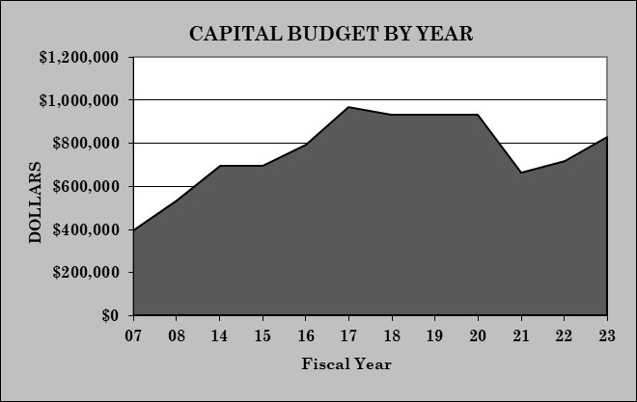
Capital Budget Highlights
Capital budget increased by $108,470. No funding for CNREF ($50,000 cut)
Sustainability level is $1,000,000 (proposed is at 82% of target)
Includes restoration of several Education projects after elimination of all projects 2 years ago at suggestion of Board to address Covid-19
In FY20 the Capital Budget was $932,000. This proposal is still $103,500 less than Pre-Covid spending (equals 0.1 mil increase)
Note: FY 95 levels, if adjusted for inflation, would be over $1,000,000

Slide 13
Capital Projects
GENERAL FUND CAPITAL EXPENDITURES:

Slide 14
Capital Projects (Continued)
LOCIP:
1 | Patriots Park Improvements | $20,000
2 | Creaser Park Improvements | $25,000
3 | Fire Pond Maintenance | $10,000
4 | Guardrails | $25,000
6 | Large Drainage Projects | $20,000
 | Total | $100,000
Other Funds:
1. | Laidlaw Park Improvements | Local Locip | $10,000
2. | Tower equipment/communications | Radio Tower Fund | $10,000
3. | Cemetery Expansion/Improvement | Cemetery Fund | $15,000
4. | Power Curber | Misc. Highway Fund | $25,000
 | Total |  | $60,000
Grants:
1 | Lake management | $35,000
2 | American Rescue Plan Funding | $1,704,500
 | Total | $1,739,500

Slide 15
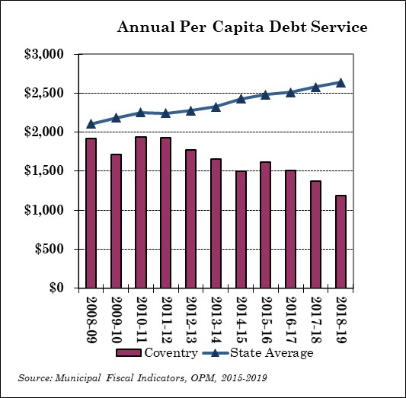
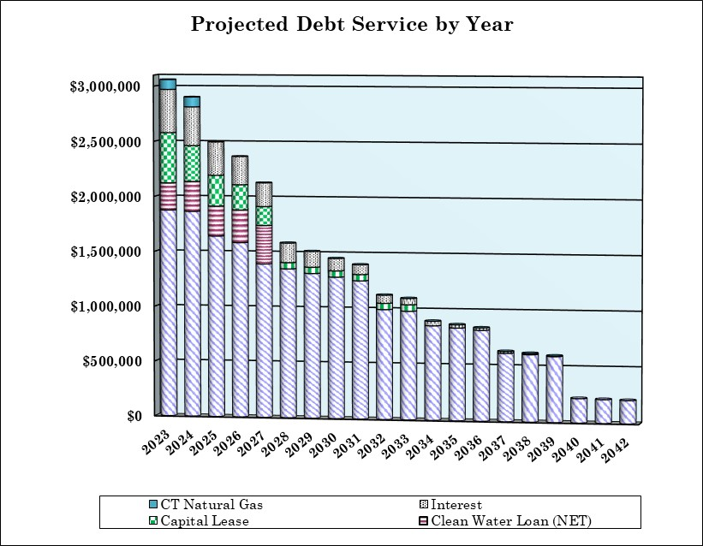
Debt Service
Debt Service is 6.68% or $190,756 increase. Includes projected issuance of debt for the library renovation ($750,000), school roof replacement ($3,105,000) and softball field ($325,000). This increase represents less than 0.2 mils.
Debt Service for the proposed bond projects is included in the budget to take advantage of debt repayment decline and attractive rates.
Debt service is 6.7% of the proposed budget.

Slide 16
Budget Vote!
Vote: Tuesday May 3th
6:00 A.M. to 8:00 P.M.
District 1: CVFA Firehouse
District 2: NCFD Firehouse
Absentee Ballots will be available at the Office of Town Clerk during business hours

