Slide 1
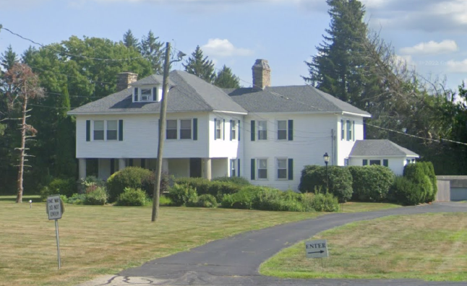
Sacred Oak Coventry, LLC – Site Plan Application
2665 Boston Turnpike, Coventry, CT
Coventry Planning & Zoning Commission
October 14, 2025

Slide 2
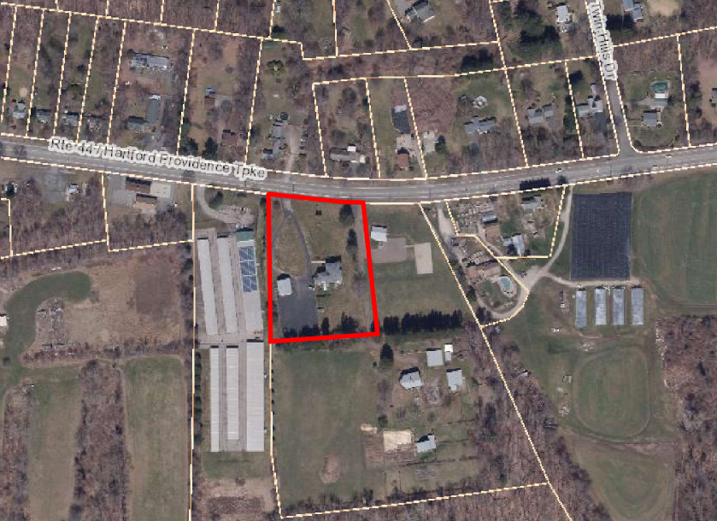
Coventry G.I.S. Aerial – Surrounding Neighborhood

Slide 3
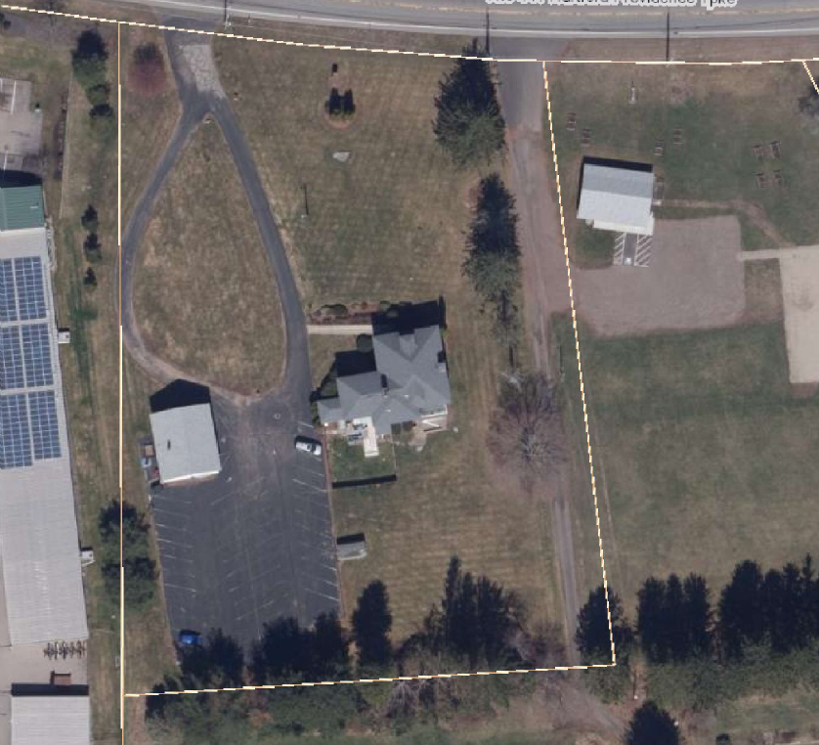
Coventry G.I.S. Aerial – Subject Property

Slide 4
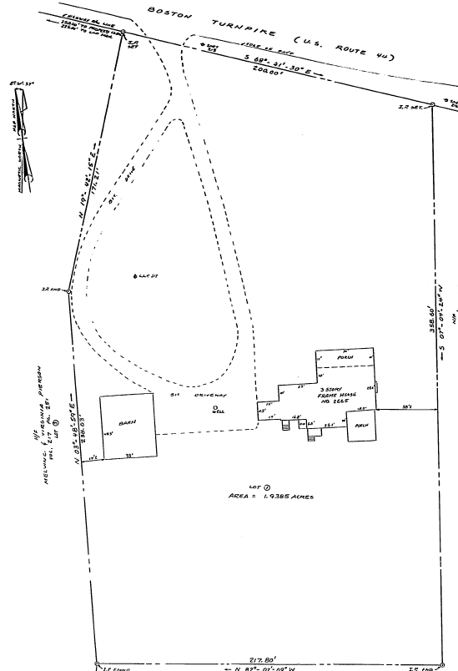
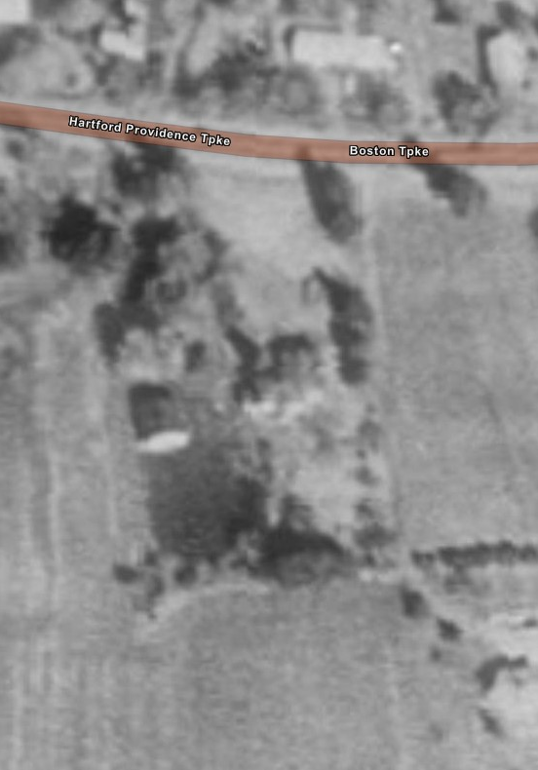
Survey, 1991
UCONN M.A.G.I.C. Aerial, 1990

